Slide 1
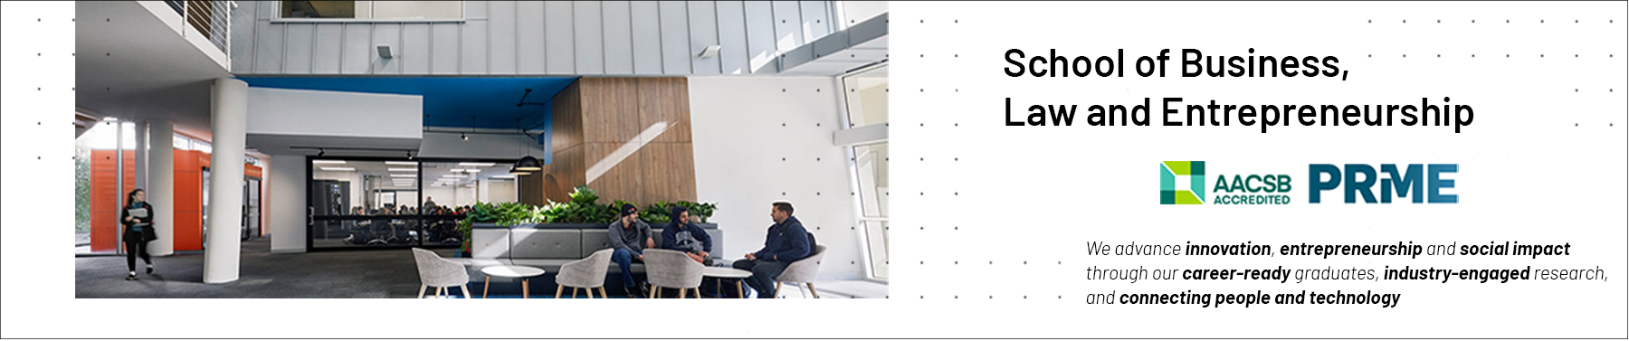

Social Capital: Presentation 1
Professional Capabilities for a Digital World

Slide 2
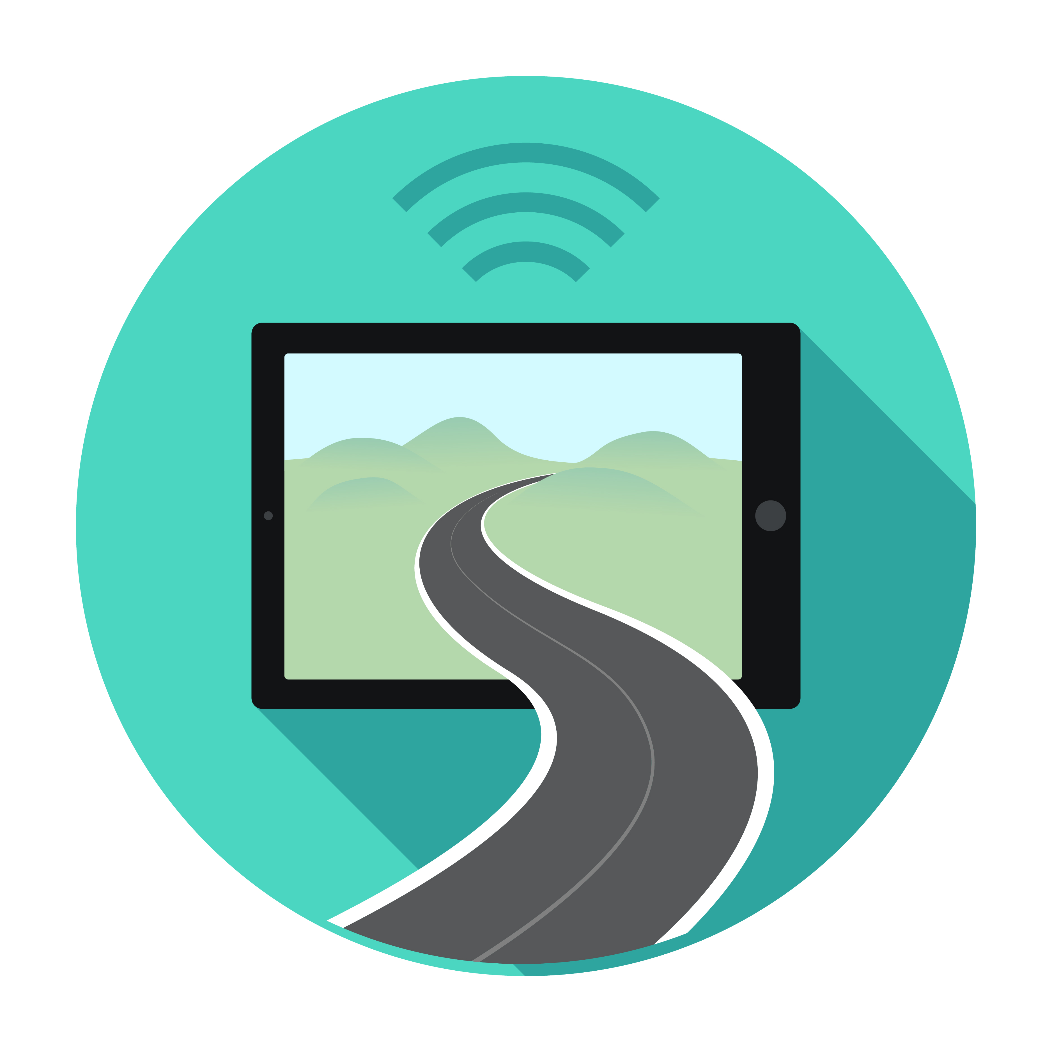
This session’s roadmap & unit learning objectives
What we will be covering.
Social Capital
Categories
Relationship between Social Capital and ICT Professionals
Unit Learning Objectives (ULOs).
Review the roles and responsibilities of ICT professionals in organisations and society from a range of perspectives such as work-life balance, mentoring and life-long learning.
What you need to do with this recorded presentation.
Watch, reflect and take your own notes.
Jot down any queries you may have on the concepts ready for the weekly LIVE catchup classes.
How long will this task take.
This task will take approx. 20 minutes to complete.

Slide 3
THIS SESSION’S OBJECTIVES
Define the concept of Social Capital.
Become familiar with the evolution of the term.
Identify the key authors and gurus in the field.
Identify some of the misunderstandings and criticisms of the theory.
Apply the theory of social capital to your current/future roles as ICT Professionals.
Be more knowledgeable after the recording than we were when we arrived.

Slide 4
SOCIAL CAPITAL / DEFINED
Networks together with shared norms, values and understandings that facilitate co-operation within or among groups (OECD).
A resource linked to having a network of relationships of mutual acquaintance and recognition (Bourdieu 1983).
Social Capital is defined by its function. It is not a single entity, but a variety of different entities having two characteristics in common: They all consist of some aspect of social structure, and they facilitate certain actions of individuals who are within the structure” (Coleman 1988).
Notes:
4

Slide 5
SOCIAL CAPITAL / DEFINED /2
SOCIAL CAPITAL CAN BE SEEN AS THE GLUE THAT HOLDS TOGETHER SOCIAL COLLECTIVES SUCH AS NETWORKS OF PERSONAL RELATIONSHIPS, COMMUNITIES OR EVEN WHOLE NATIONS.
Notes:
5

Slide 6
SOCIAL CAPITAL / DEFINED /3
‘Relationship-essential Capital’.
Stable relationships create honour and reputation among its members.
Builds & maintains trust.
The relationships among the group members are sustained by material and/or symbolic exchanges (for example gifts or greeting each other when meeting on the street).
Depends on who one knows and how well one understands one’s social relationships.
Notes:
6

Slide 7
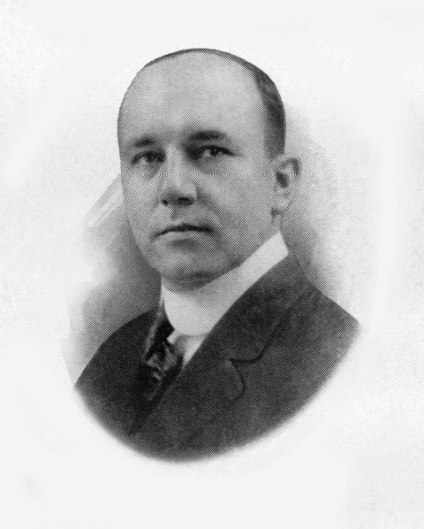
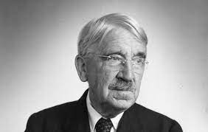
SOCIAL CAPITAL
Evolution of the term
First use is credited with Lyda Hanifan (1916). This is disputed.
John Dewey (1907)
Pierre Bourdieu (1980s)
James Coleman (1980s)
Robert Putnam (1990s)
Alejandro Portes (1990s)
Francis Fukuyama (1990s)
Lyda J. Hanifan (1887-1932)
John Dewey (1859-1952)

Slide 8
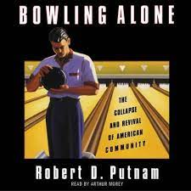
SOCIAL CAPITAL
Putnam (2000) defined social capital as the…connections among individuals—social networks and the norms of reciprocity and trustworthiness that arise from them (p. 19).
Analogy of ten pin bowling alone has been used to show the decline in community participation in America.
Social capital theory develops around value inserted into social networks.
Potential benefits for individuals who are connected, in various forms such as valuable information acquisition, financial gain, job creation, education diffusion, or other instrumental and emotional support.
Notes:
8

Slide 9
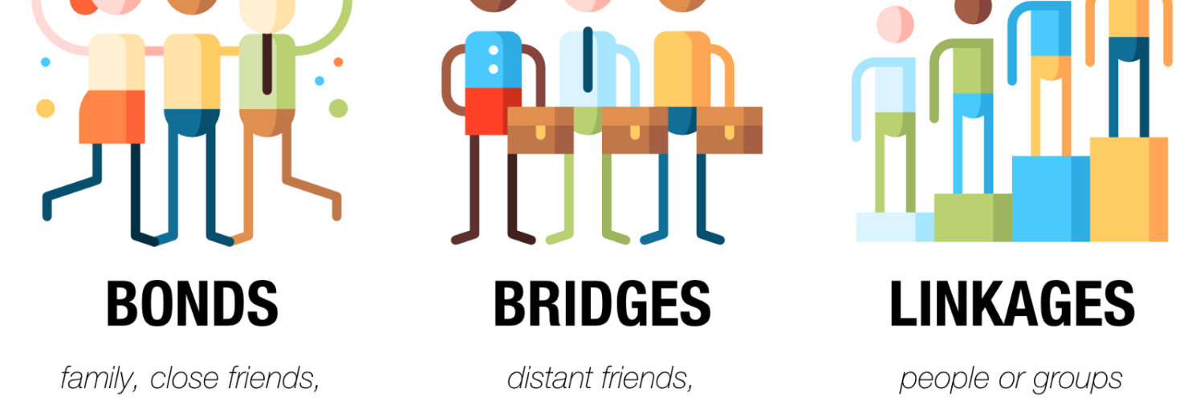
BONDING, BRIDGING & LINKING TYPES
Notes:
9

Slide 10
CORE DIMENSIONS OF SOCIAL CAPITAL
Three core dimensions of social capital identified in literature are:
Trust (Barber, 1983; Fukuyama, 1995; F. Fukuyama, 1999; Russell Hardin, 1996; Putnam, 1993; Robbins & Langton, 2003);
Reciprocity (Gouldner, 1960; Molm, 2010); and
Norms (Baland & Platteau, 1996; Bulte & Horan, 2010; Esser, 2008; Fukuyama, 1995).
Reciprocity and trust in particular are key elements of pro-social behaviour; a behaviour characterised by exchanges of favours between non-related individuals (Camerer, 2003).
Notes:
10

Slide 11
CORE DIMENSIONS OF SOCIAL CAPITAL / TRUST
Fukuyama (1995) defines trust as “the expectation that arises within a community of regular, honest, and cooperative behavior, based on commonly shared norms, on the part of other members of that community” (p. 26).
Trust is usually conditional and limited but may be unconditional, although this is less common outside the special relationships between parents and young children (Kohn, 2008).
Alesina (2002) distinguishes between two types of variables correlated with trust: individual characteristics, such as age, gender, race; and characteristics of the community in which the individual lives.
Notes:
11

Slide 12
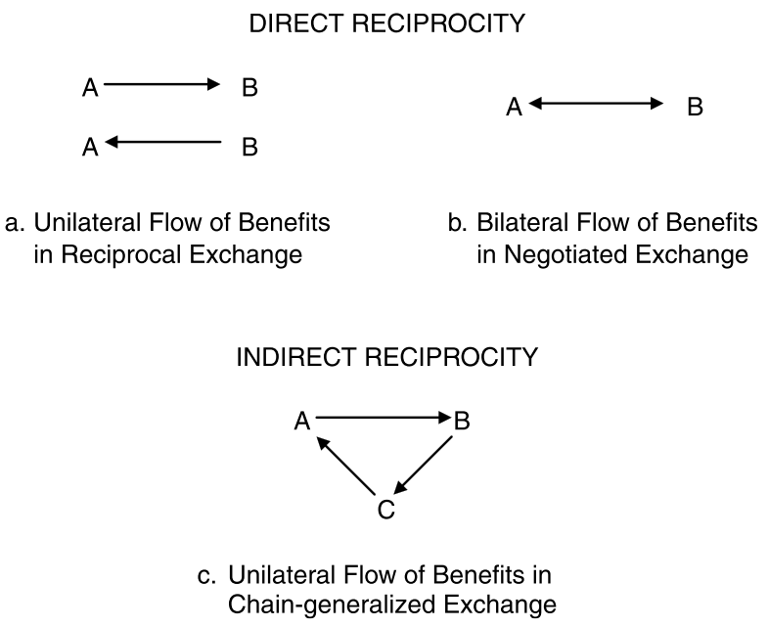
CORE DIMENSIONS OF SOCIAL CAPITAL / RECIPROCITY
“A principle or practice of give-and-take…” (The Australian Pocket Oxford Dictionary, 1984, p. 575) and “…the conditional behavior to return helpful and harmful acts in kind, even when this is costly for the reciprocator” (Stanca, 2009, p. 191).
Reciprocity is a universal social phenomenon subject to cultural variation which has been found to be a useful catalyst of exchange and social relations (Gouldner, 1960).
Notes:
12

Slide 13
CORE DIMENSIONS OF SOCIAL CAPITAL/ NORMS
According to Fukuyama (2001), social capital consists of “norms or values, instantiated in an actual relationship among two or more people, that promote cooperation between them” (p. 480).
A norm is defined as a “recognized type, standard” (The Australian Pocket Oxford Dictionary, 1984, p. 462).
Finnemore (1996) defines norms as “shared expectations about appropriate behaviour held by a community of actors”.
Expectations and beliefs about how one should behave (Baland & Platteau, 1996).
Violating the norm is intrinsically costly as it causes feelings of guilt and shame (Bulte & Horan, 2010).
Notes:
13

Slide 14
SOCIAL CAPITAL / NEGATIVE ASPECTS & POSSIBLE MISUNDERSTANDINGS
Social capital is best studied long-term (longitudinal) with regular investigations (of the subject/s).
Authors such as Putnam believe social engagement decaying but perhaps it is simply evolving.
The theory has been critiqued for its failure to address the gender dimension of social capital.
This should be considered for your investigative case study.
There is the potential for the ‘wrong type’ of social capital.
Relationships between colleagues that are too inward-looking and fail to take account of what’s going on in the wider world.
Ku Klux Klan and the Mafia achieve cooperative ends on the basis of shared norms, and therefore have social capital, but…
Notes:
14

Slide 15
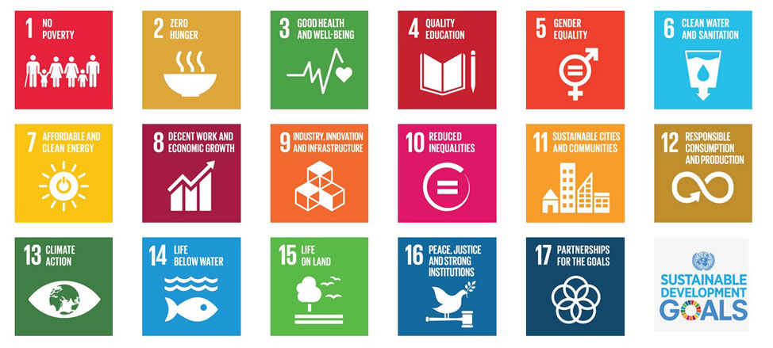
SOCIAL CAPITAL FOR THE UNSDGs
Notes:
15

Slide 16
SOCIAL CAPITAL FOR YOUR
INVESTIGATIVE CASE STUDIES
IN YOUR GROUPS, CONSIDER POTENTIAL MEMBERS OF THE COMMUNITIES FOR YOUR PROPOSED PROJECT, WHO MAKE UP THE BONDING, BRIDGING AND LINKING TYPES OF SOCIAL CAPITAL.
WHO ARE THEY?
HOW ARE THEY LINKED?
Notes:
16

Slide 17
YOUR TOUCHPOINTS WITH SOCIAL CAPITAL AS AN ICT PROFESSIONAL
Bonding, Bridging, Linking
Think of examples of where your social capital is being built
Map out how you can transform your Social Capital to Human Capital to Economic Capital.
I have done this for you when you arrive at the CoP touchpoints!
Notes:
17

Slide 18
HAVE WE MET OUR SESSION’S OBJECTIVES?
Defined the concept of Social Capital.
Became familiar with the evolution of the term.
Identified the key authors and gurus in the field.
Identified some of the misunderstandings and criticisms of the theory.
Explored how the theory of social capital can be applied to your current/future roles as ICT Professionals.
Are more knowledgeable on the topic now than when we arrived

Slide 19


